Slide 1
Mission 10 Remix
Create your own project from Mission 10

Slide 2
Warm-up
Mission 10 introduced a way to use the computer clock. You used it for timing your reaction to a light by pressing a button.
What else could you use the computer clock for?
Besides a light, what else can you measure your reaction to?

Slide 3
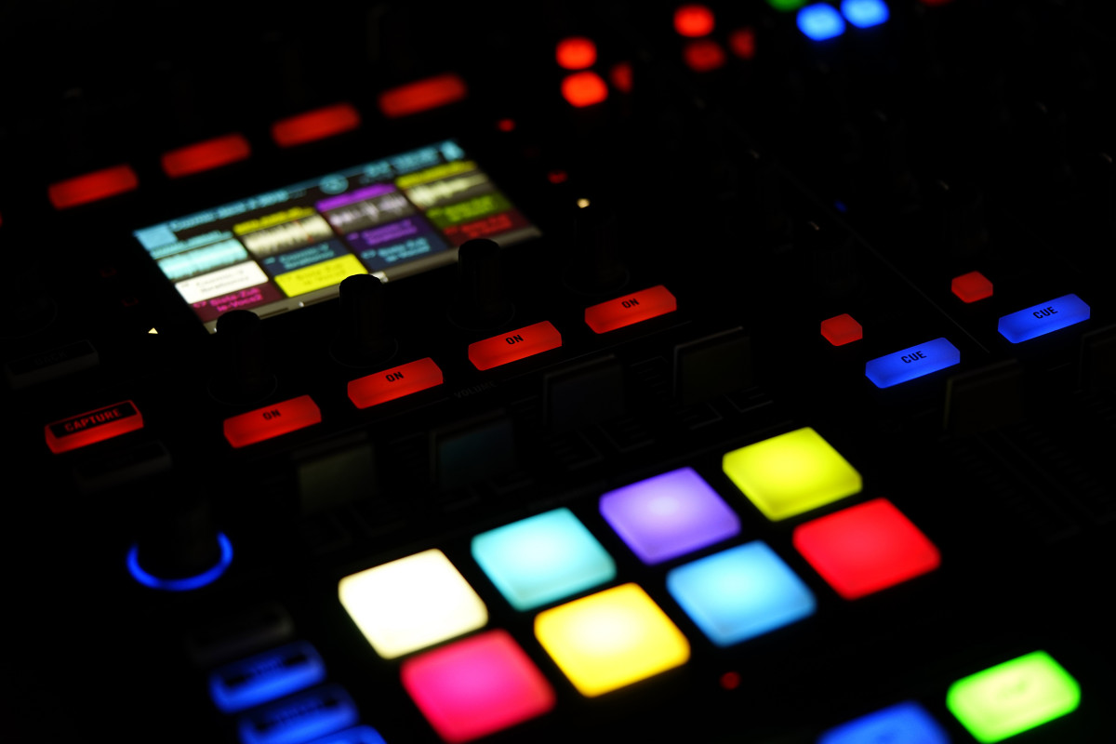
Time for a project remix!
A remix can be:
A new program created by adding new code to a program you already created
You can combine parts of two or more programs in a remix
Use a similar idea in a different way

Slide 4
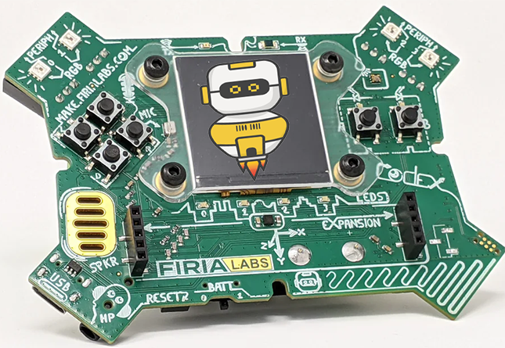
Project Remix
Creating a remix will let you:
Improve your skills and practice the concepts from the mission
Be creative
Remember code from earlier programs and missions
Work with other students
Design an original program and write the code all on your own

Slide 5
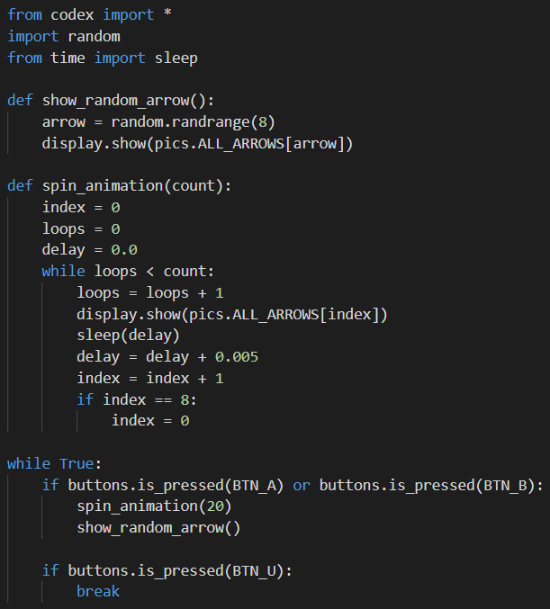
Step #1
Review the mission
Open your project from Mission 10
What does the program do?
What skills were used or concepts learned?
DO THIS:
Fill out the information in the Mission 10 Remix Log for Step 1

Slide 6
Step #2
Brainstorm ideas
Read through remix suggestions from your teacher
Eight suggestions are on the next 4 slides. You can use any of these ideas or come up with your own.

Slide 7
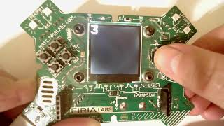
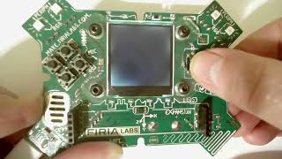
Step #2 Remix Ideas
Mild-1A
The code inside the loop is very long. Create a function for the countdown code.
Mild-1B
Create a function that will give an introduction and wait to start the game (use the wait() function).

Slide 8
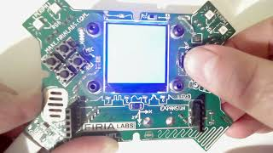
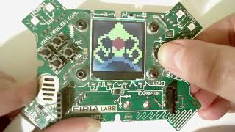
Step #2 Remix Ideas
Medium-2A
Create a list of colors, and select a random color for the display screen. Use the screen as the indicator instead of pixels.
Medium-2B
Create a list of images, and select a random image for the display screen. Use the screen as the indicator instead of pixels.

Slide 9
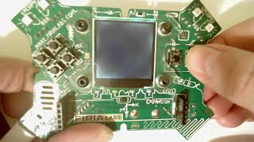
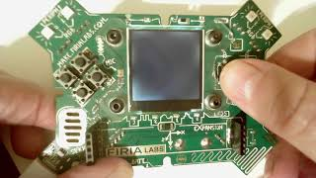
Step #2
Spicy-3A
Make the reaction tester into a game. Use the average time of your reactions as the deciding point. If your time is better than average, add a point. As an option, also subtract a point for slower times.
Spicy-3B
Use two images: one for Button A and one for Button B. Select a random button and see if the player presses the correct button. If so, add a point to the score.

Slide 10
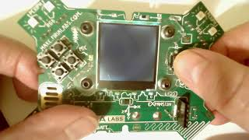
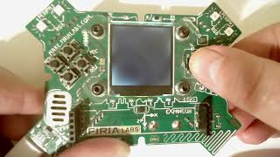
Step #2
Extra Spicy-4A
Add to Spicy 3A. Choose a way to win or lose the game. Here are two possibilities: #1 - Run the test 20 times. If the player scores at least 15 points, they win. #2 - Player wins if they get 5 points before getting -5 points, or loses if they get -5 points first.
Extra Spicy-4B
Use the L, R and U buttons to determine which indicator to use. For example, L for pixels, R for images and U for colors. As an extra challenge, use D for a random selection.
Video of Remix #4BB
Video of Remix #4AA

Slide 11
Step #2
Brainstorm ideas
Read through remix suggestions from your teacher (previous slides)
Use the suggestions as presented, or combine some of the options for your own mild, medium, spicy or extra spicy project
Use your creativity to come up with your own idea for a project
Decide with your partner what project you will do
DO THIS:
Fill out the information in the Mission 10 Remix Log for Step #2

Slide 12
Step #3
Make a plan
What variables will you need? What will you use them for?
What functions will you create for the program?
Do you need a list? If so, what information will it store?
What buttons will you program, and what will each button do?
DO THIS:
Fill out the information in the Mission 10 Remix Log for Step #3

Slide 13
Step #4
Code your project
IMPORTANT: In CodeSpace, go to the sandbox
Start with a new file and give it a descriptive name (Remix10)
You can leave any program open, including Reaction Time, and use it as a guide
Import your modules
Create functions as you go, or when you see a need
Write your code, testing frequently

Slide 14
Step #4
Stop and test frequently!
Don’t try to write all the code at one time
Think about the steps:
Just get one thing to work, then move on
Step by step!
Mistakes happen, so find them early
Type just a few lines of code and then run the program
If there is an error, fix it before continuing
Use the debugger and your other programs for help

Slide 15
Step #5
Documentation!
Make sure your code is readable by adding blank lines
Add comments to sections of your code that explain what they do

Slide 16
Step #5
Get feedback
Show your code to other students.
What do they think? Have them fill out the feedback form on your Mission 10 Remix Log.
The Mission Log has space for two people to give feedback. The feedback can come from two peers or one peer and yourself.
Modify your code to make your project even better

Slide 17
And now you have your own remix!
Congratulations!
By completing this remix you have:
learned more about programming
practiced the skills and concepts from the missions
been thinking! And problem solving and much more!

Slide 18
Mission Reflection
Wow! Great job!
Share your project with your friends!
Run projects from other students
Complete your Mission 10 Remix Log
Don’t forget to clear your CodeX by running your Clear program

